Slide 1

ScribOrder Records Request Instructions
Step by step instructions on how to place a records request

Slide 2
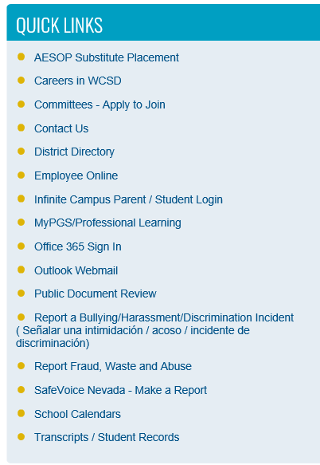

Visit www.washoeschools.net to go to the W.C.S.D. Homepage
Go to Quick Links & Click on Transcripts / Student Records
Click on the Backpack Icon:
Click Here If you are a CURRENT student and would like to order your student records or transcript

Slide 3
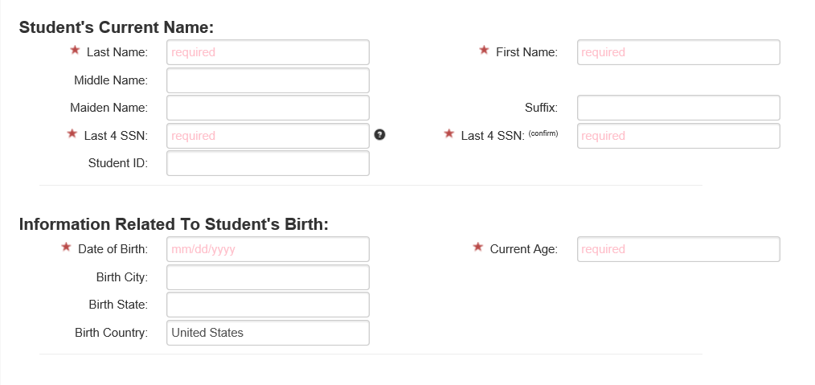
Complete all fields with a red star

Slide 4
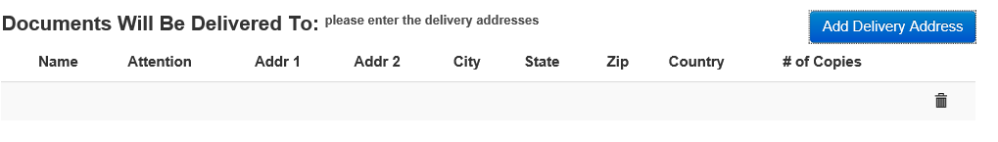
Delivery Address:
Add Delivery Address: This is where you will add the delivery address to have the records sent electronically to the college you are applying for

Slide 5
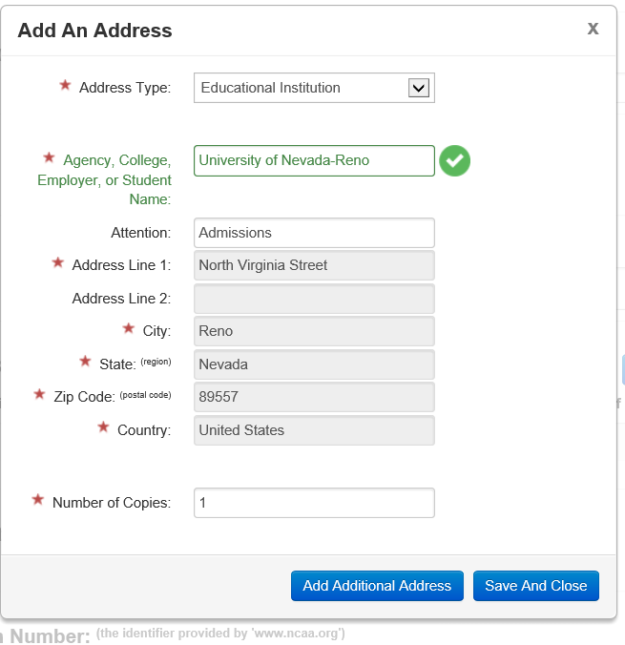
Select Education Institution, then type the name of the college. If they have set up electronic delivery the name will pop up. Click on the name and it will auto populate the admission address for you. If it doesn’t auto populate that college has not set up electronic delivery and you will need to complete ALL fields manually. SAVE AND CLOSE

Slide 6
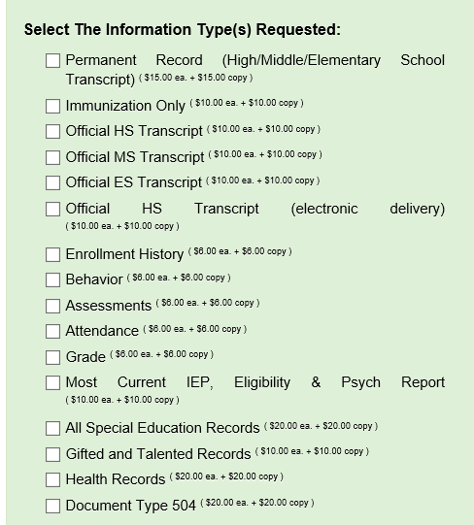
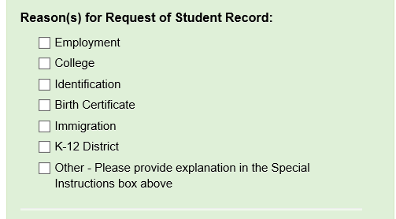
Select the Reason for the request and what records you are requesting

Slide 7
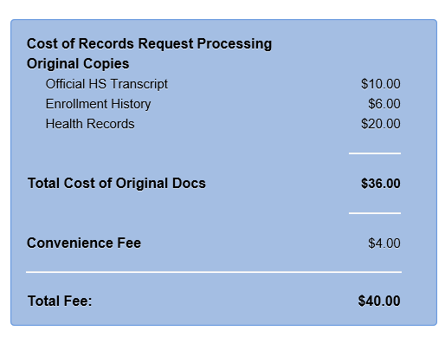
There are fees associated with each record type. As you select what records you are requesting the fee box will add them up. Please note: Each student received four (4) FREE records request each school year. Once you receive the first four (4) Free records you will be charged starting the fifth (5) records request.

Slide 8
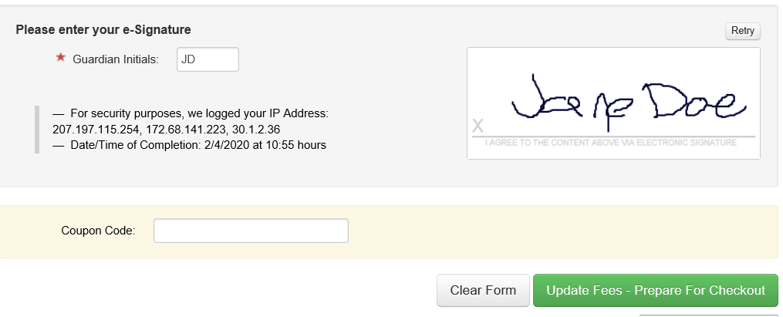
Enter your initials and create your electronic signature
Click here for check out

Slide 9
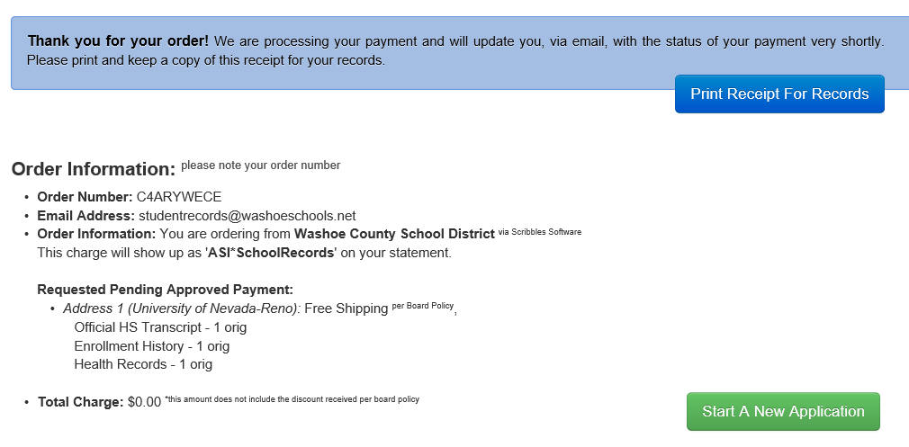
Hooray – You will receive your Order Confirmation

